Slide 1

Feasibility and Cost of Renewable Power Injection Into the Energy Grid
DAEN 690 | Fall 2017
Ashish Chhabra Britney Weber Ishan Singh
Jamie Wheeler
Saurabh Rao

Slide 2
Agenda
Topic | Content | Presenter
Overview | Problem Proposed Solution | Jamie
Data Processing | Data Gathering Data Consolidation Science-y Part | Saurabh/Britney
Modelling | Data Preparation Feature Engineering Regression Model Visualization | Ishan/Ashish
Impact | Electricity Cost Simulation | Jamie
Wrap up | Conclusion Next Steps | Jamie/Britney
Notes:
motivator and obstacle… increase political pressure is an economic impact at home...this will generate more sociopolitical pressure to move to an open market for renewable energies which people can buy and sell power… constrained by weather intermittency.

Slide 3

Overview

Slide 4

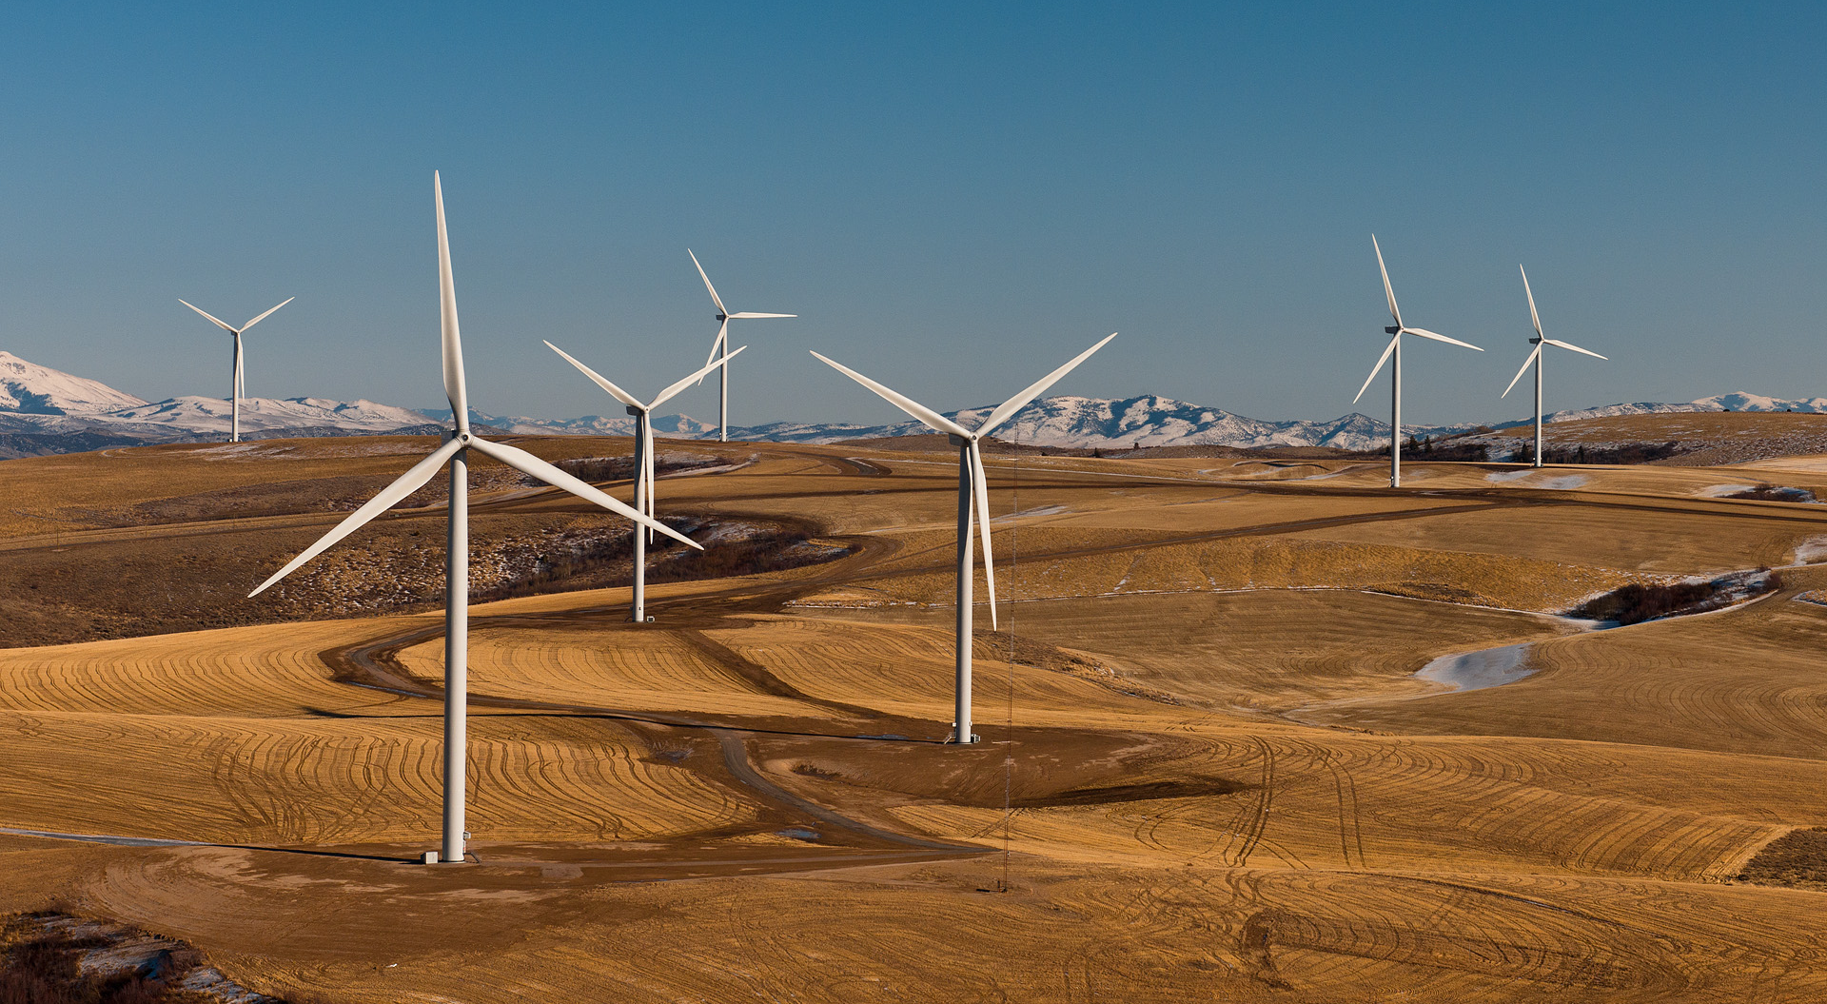
The Problem
Social and political pressures are growing to increase renewable injection into the energy market. This also results in social and political constraints.
01
Not all power needs can be met simply by adding more renewable sources. It has high intermittency and technical constraints.
02
03
Is there an economic motivator to implement greater renewable energy injection into the energy market?
Notes:
pressures create constraint, politicians need to be on board, etc. can’t meet need by just throwing renewables into the market isn’t the answer. If demand != production, then you have heat let over and burning out generators. If you don’t produce enough to meet demand you have black/brown outs. Spin generating kinetic something? Can’t throw batteries at the problem because they have ramp up something at this scale. So the question is … is it even cost effective to ramp up renewables? We are proposing decentralizing … long road to get here. Demonstrate lower cost, we examined the following sets: xyz.
Social and political pushes to inject more renewable energy in electric grid around the world [problem we are trying to solve is to determine if economically and technically feasible and if the factors that control and affect it are knowable.
There is a significant push to inject more renewables, but there have been barriers. One barrier we are address is economic feasible at the home. The reason why we are address home economic feasibility, because if you can demonstrate cost saving at home people will want it! And what we’ve seen, social-political pressure is the biggest motivator to reducing cost of electricity. If you can reduce your cost of electricity, you can reduce the cost of everything. but it is economically beneficial to do so by opening up the markets to free trade, by decentralizing and opening markets up to trade.

Slide 5
The Solution
Distributed and decentralized generation offers possible solutions to inject renewable power into the grid.
Our Approach
To facilitate this we suggest that cost of electricity to the home can be used as an economic indicator of feasibility, i.e., lower cost at home as a result of decentralization is more likely to compel adoption and promote renewable injection.
To demonstrate this lower cost at the home, we did the following:
Explored data sources
Gathered data from disparate sources
Consolidated and processed data into new master data set
Interpolated, curated, and added physics to data
Tested and validated descriptive models
Simulated different electricity markets
Key Data Assumptions
Large number of policies indicate significant sociopolitical pressure
Relative policy count has not changed over time significantly per state, so static policy count was used
Data aggregated at the month level is sufficiently granular
Notes:
pressures create constraint, politicians need to be on board, etc. can’t meet need by just throwing renewables into the market isn’t the answer. If demand != production, then you have heat let over and burning out generators. If you don’t produce enough to meet demand you have black/brown outs. Spin generating kinetic something? Can’t throw batteries at the problem because they have ramp up something at this scale. So the question is … is it even cost effective to ramp up renewables? We are proposing decentralizing … long road to get here. Demonstrate lower cost, we examined the following sets: xyz.
Social and political pushes to inject more renewable energy in electric grid around the world [problem we are trying to solve is to determine if economically and technically feasible and if the factors that control and affect it are knowable.
There is a significant push to inject more renewables, but there have been barriers. One barrier we are address is economic feasible at the home. The reason why we are address home economic feasibility, because if you can demonstrate cost saving at home people will want it! And what we’ve seen, social-political pressure is the biggest motivator to reducing cost of electricity. If you can reduce your cost of electricity, you can reduce the cost of everything. but it is economically beneficial to do so by opening up the markets to free trade, by decentralizing and opening markets up to trade.

Slide 6

Data Gathering and Consolidation

Slide 7
Data Identification
Evaluate potential data sources
Identify data sources
Identify data points
01
02
03
Identify Project Goals
Electricity Data
eia.gov
Peer Validation
Research Data Sources
Data Sources
Weather data power.larc.nasa.gov
Data points
Government policy data dsireusa.org
Validate Data Relevance to Project Goals
Electricity | Weather | Government Policy
Year | Day | State
Month | Year | Total renewable energy policy count
State | Month | Wind energy policy count
Net generation other renewables (total) (thousand megawatthours) | Latitude | Solar photovoltaic energy policy count
Average retail price of electricity (cents per KWH) | Longitude
Retail sales of electricity (million kilowatthours) | Temperature
Revenue from retail sales of electricity total(million dollars) | Wind speed
Revenue from retail sales of electricity residential (million dollars) | Solar Insolation Index
Total consumption coal (thousand tons)
Total consumption petroleum liquid (thousand barrels)
Total consumption natural gas (thousand Mcf)

Slide 8
Data Gathering – Electricity Data
Process Flow
Data Structure
Successive processes implemented for gathering data
Year: [2001:2017] Month: [1:12] State: [AL:WY] Categories: [Average retail price of electricity Residential
,Net generation By fuel type All Solar
,Net generation By fuel type Other renewables
,Net generation By fuel type Small scale solar photovoltaic Residential
,Net generation By fuel type Wind
,Retail sales of electricity Residential
,Revenue from retail sales of electricity
,Revenue from retail sales of electricity residential
,Total consumption By sector Electric power (total) coal+petroleum liquids+petoleum coke+natural gas]
Data collection and parsing
Webpage collection
Use BS4 , Pandas & dump data to a CSV by Category
Unique ID identification
Get unique webpage X
For all distinct Month, Year, State, Category ∈ X
Loop

Slide 9
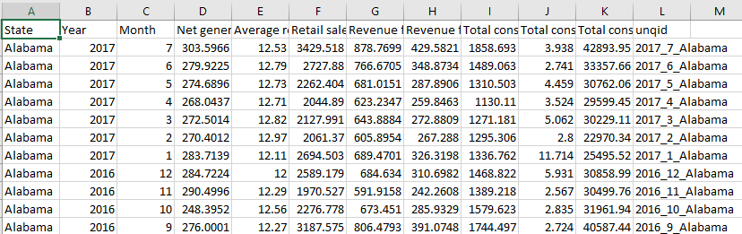
Data Consolidation – Electricity Data
Create a unique ID column as State_Year_Month for each category
Perform outer join
Remove redundant columns
Perform data accuracy checks by verifying year_month and state counts
Dump DataFrame to CSV
01
02
03
04
05

Slide 10
Data Gathering– Weather Data
Stage 01
Coordinate identification
Choose a (lat,lon) coordinate to begin with – I started with the Nyugen Building
Set square boundaries for the United States
Get all possible (lat,lon) combinations in that square
Use Google Maps API to label coordinates not in the USA
Remove non-USA coordinates, keep the ones in the country

Slide 11
Data Gathering– Weather Data
Stage 02
Data requests and raw dataset generation
Use Selenium to get Insolation Index , Temperature and Wind speed for each coordinate as a text file
Process text file outputs, convert to CSV
Append CSV files into master dataset

Slide 12
Data Gathering– Weather Data
Stage 03
Label annotation and data consolidation
Load master dataset in Pandas
Use google maps API to generate State for each coordinate
Aggregate data by month ( from days -> month ) by min , max , mean.
Download CSV

Slide 13
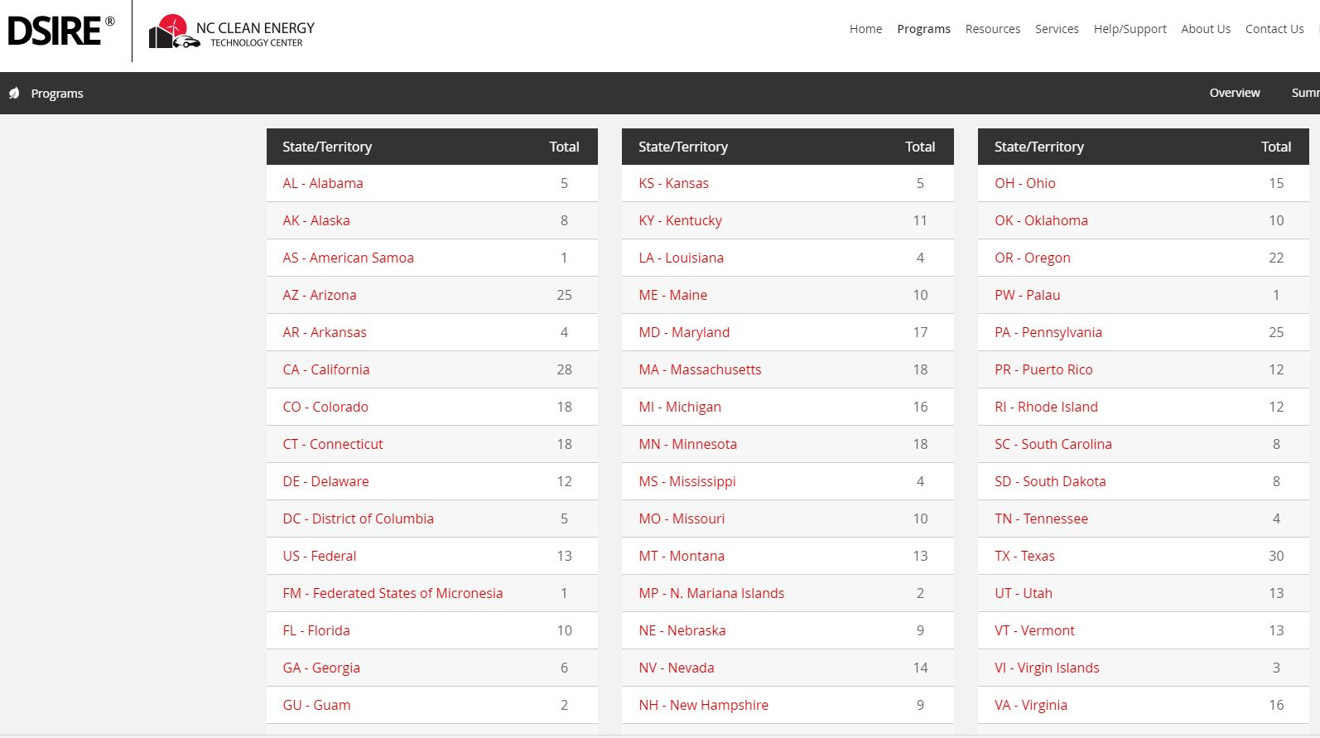
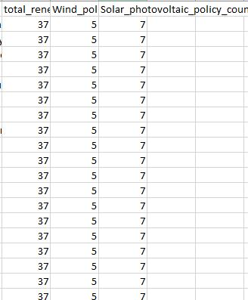
Data Gathering and Consolidation – State/Local Government Policy Data
Get to webpage using requests,Pandas,BS4
Download data
Add State column
Write to CSV
01
02
03
04

Slide 14
Final Data Consolidation
Merge Electricity, Weather, and Government datasets
Electricity on State_Year_Month
Weather on State_Year_Month
Final cleanup
Government policy on State
Standardize all units to SI units
Dataset !

Slide 15
Logic
Wind Energy Production
Solar Energy Production
CO2 Emissions*
Energy = 1.93 * V^3 * R^2 * Cp (watts)
1.93: Constant
V: Velocity (so, location matters)
R: Radius of the windmill (bigger the diameter of the windmill more generation)
Cp: (Maximum power coefficient) Efficiency [varies from 0.25 to 0.45, with a max of 0.59]
We are using R = 35.3568 [minimum size of blade for a wind mill]
Cp = 0.35
Total Solar theoretical production at the top layer of earth:
E = 1367 * R^2 * Kt * Cp
1367: Constant
R: Area
Kt: solar radiation index
Cp: (Maximum power coefficient) range [0.24 to 0.34] max at 0.45 -> we will use 0.29
Pounds of CO2 emitted per million British thermal units (Btu) of energy for various fuels:
Coal (anthracite) 228.6
Coal (bituminous) 205.7
Coal (lignite) 215.4
Coal (subbituminous) 214.3
Gasoline (w/out ethanol) 157.2
Natural gas 117.0
EIA energy consumption data for coal, natural gas, and petroleum were converted to MWh, and then to Btu to calculate the kgs of CO2 emissions produced.
*https://www.eia.gov/tools/faqs/faq.php?id=73&t=11

Slide 16

Modelling

Slide 17


Welcome to !

Slide 18

Impact

Slide 19
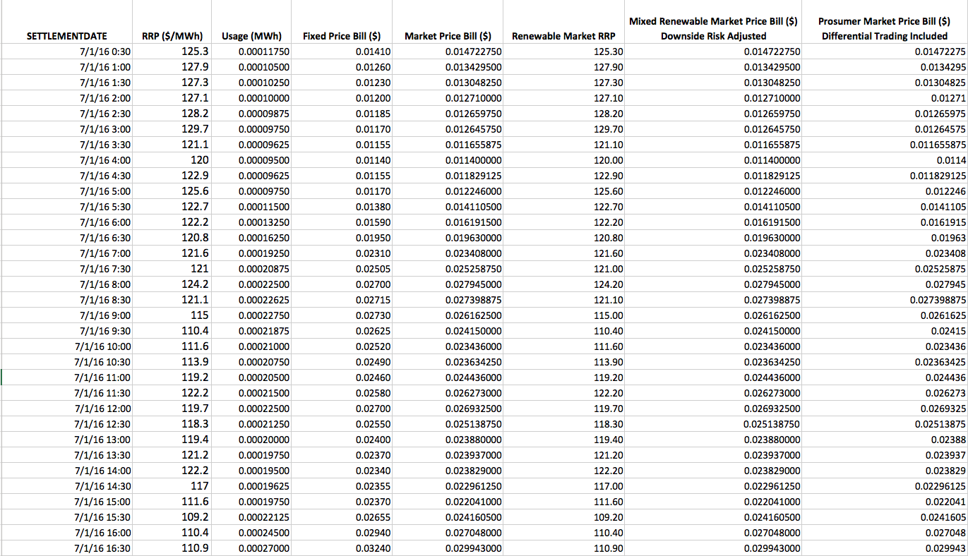
Simulated Use Case

Slide 20
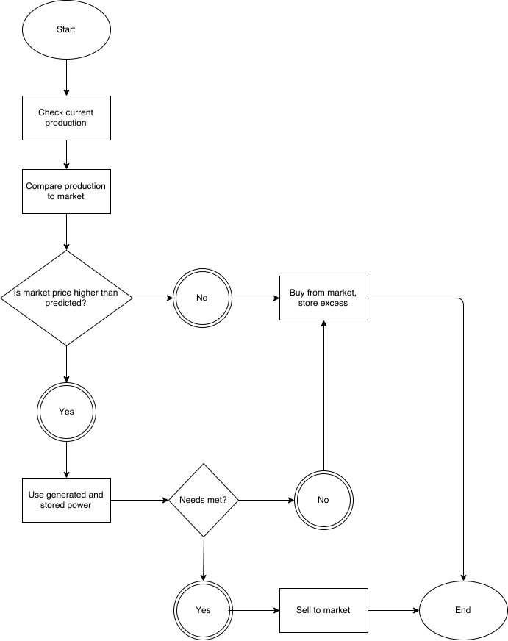
Simulated Use Case
Electricity Prices and Constraints
Price to Sell Domestic Solar Into Grid | EIA data | 150 | $/Mwh
Fixed Electricity Price from Grid | average of US | 120 | $/MWh
Maximum Feed Rate into Grid |  | 1 | kW/hr

Slide 21
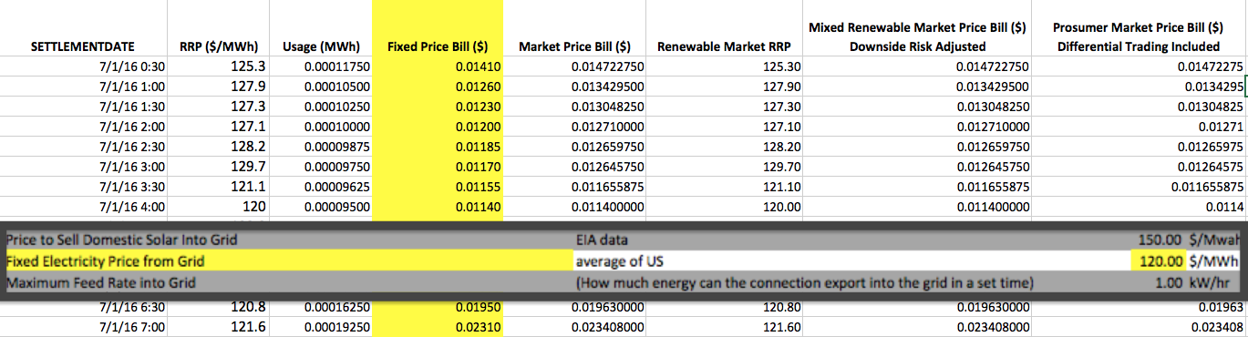
Simulated Use Case

Slide 22
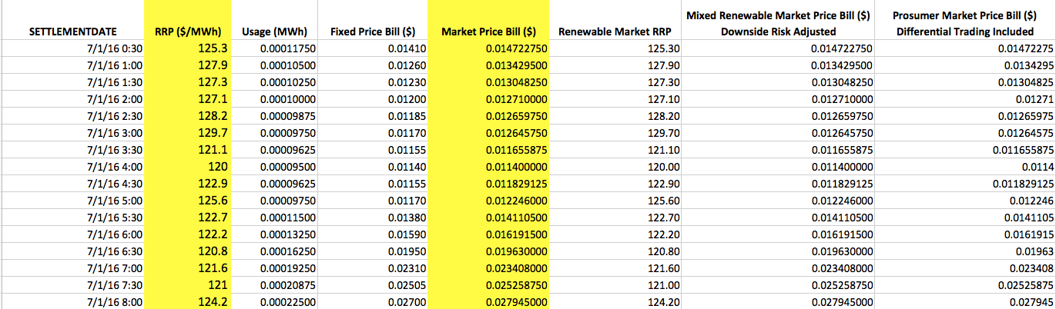
Simulated Use Case

Slide 23

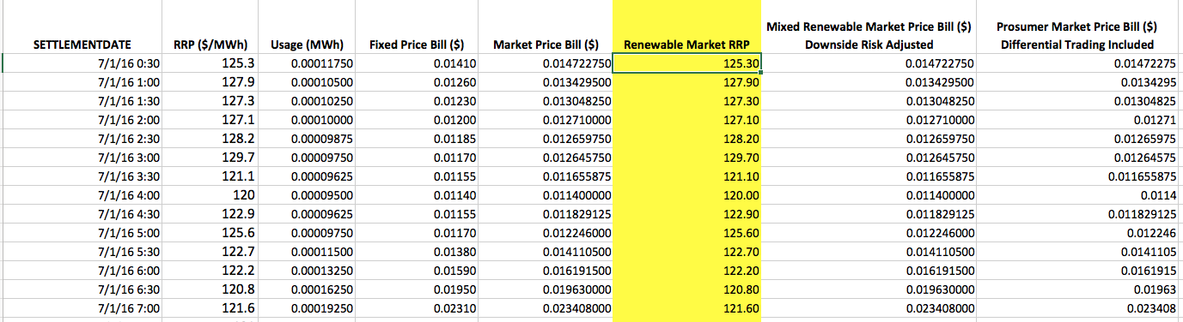
Simulated Use Case
If RRP > Price to Sell to Grid
Then Market Price = Price to Sell to Grid
Else Market Price = RRP

Slide 24
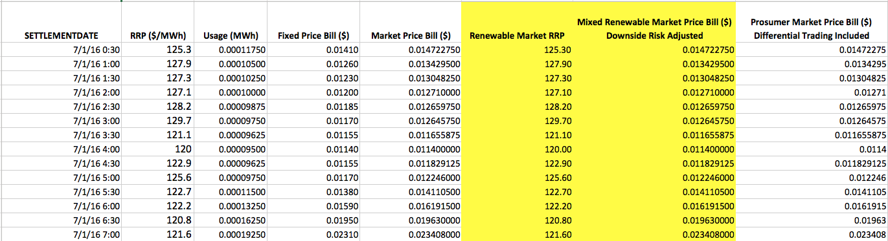
Simulated Use Case

Slide 25
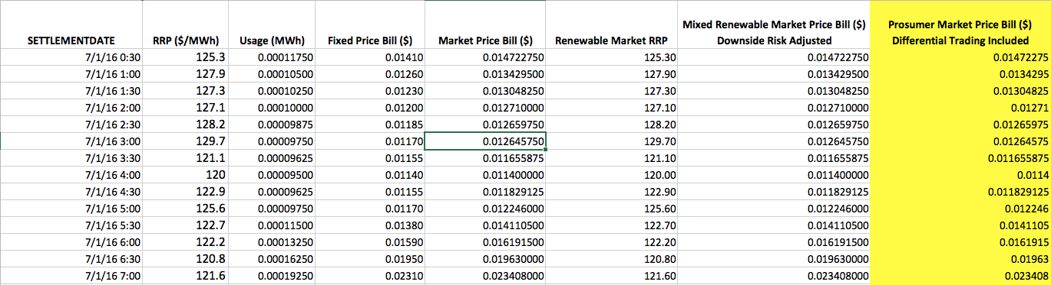
Simulated Use Case
If RRP > Price to Sell to Grid
Then Price = -RRP * Price to Grid* Feed Rate (sell the difference)
Else Renewable Market RRP

Slide 26
Simulated Use Case Result
Average U.S. Electricity Bill: $110.21
Market Electricity Bill: $98.78
Simple Renewable Market Electricity Bill with no Sell Back: $96.50
Transactional Prosumer Market Electricity Bill: $39.31

Slide 27

Wrap Up

